Slide 1

Phishing Detection Using Machine Learning
Prepared by: khaled Almir
Supervisor: Dr. Natasha Alkhatib
Position: AI Red team intern at VersifAI

Slide 2
What is a Legitimate Website vs a Phishing Website
Legitimate website
  Operated by a real organization or person and designed to provide genuine content or services.
  Uses valid domain, secure connections (HTTPS), consistent branding, and clear contact/legal info.
Phishing website
  Fake site created to impersonate a legitimate one to steal credentials, payment data, or install malware.
  Often uses look‑alike domains, spoofed logos, urgent messages, and forms that request sensitive info.

Slide 3
Example
https://www.paypal.com – official PayPal site
https://www.paypa1-login.com – fake site mimicking PayPal
Attacker finds open redirect or injects a link on legit.com.
Victim clicks a link that appears to belong to legit.com.
The site redirects the user to https://www.paypa1-login.com.
User sees a cloned login page, enters credentials → attacker collects them.

Slide 4
What Is the Goal of This Project?
This project aims to detect and classify websites as either legitimate or phishing using machine learning.
The model learns from website features (like URLs, links, forms) to predict if a site is safe or not.
To help users and security teams identify phishing threats automatically and prevent attacks before they happen.

Slide 5
How This Project Can Be Useful
For Non-Technical Users (Any User)
  Warns if a link might be fake or dangerous.
  Helps prevent accidentally giving passwords or sensitive info to attackers.
  Can be used in browsers, emails, or apps to show “safe” or “suspicious” links.
  Protects everyday users from phishing attacks without needing technical knowledge.

Slide 6
How This Project Can Be Useful
For Technical Users (Cybersecurity / SOC Analysts)
  Scores URLs automatically and flags high-risk links for investigation.
  Adds confirmed phishing URLs to blocklists or firewall rules.
  Speeds up threat detection, reduces analyst workload, and strengthens organizational security.

Slide 7
Machine Learning Model Used
Type: Supervised Machine Learning
Algorithms Used:
  Logistic Regression: for baseline classification and interpretability.
Type of Classification
Binary Classification:
The model predicts two classes:
  0 → Legitimate Website
  1 → Phishing Website

Slide 8
Logistic Regression Model
A supervised machine learning algorithm used for binary classification problems.
It predicts the probability that an input belongs to one of two classes (e.g., phishing or legitimate
A threshold (e.g., 0.5) decides the final prediction:
  If ≥ 0.5 → Phishing (1)
  If < 0.5 → Legitimate (0)

Slide 9
Random Forest Classifier
A machine learning algorithm that combines many decision trees to make a final prediction.
Each tree gives a vote, and the majority vote decides if a website is phishing or legitimate.
How It Works:
  Creates multiple decision trees from random samples of the data.
  Each tree learns different feature patterns.
  The final prediction is made by averaging or voting among all trees.

Slide 10
Random Forest Classifier
Why Used in This Project:
More accurate and robust than a single model.
Handles complex patterns in phishing data better.
Reduces errors and avoids overfitting.

Slide 11
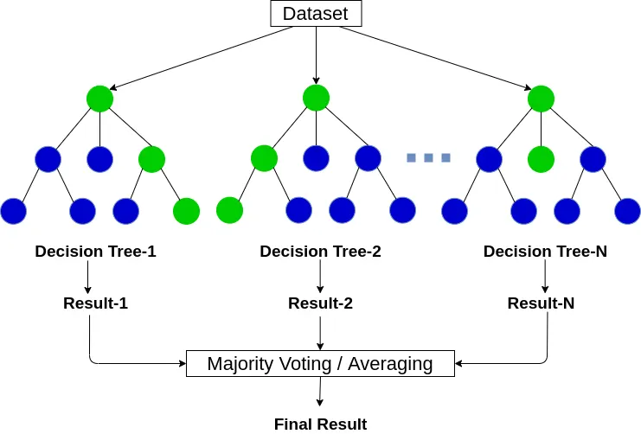
Random Forest Classifier

Slide 12
Thanks for your attention!!

